Slide 1
Test Plan for Student Assistant System
Tested by: WAMS TEAM
Joanna De Guzman Miguel Mayor
Adrian Tobias

Slide 2
Introduction
APC Student Assistant System is a web-based system storing information on both Student Assistant and Disciplinary Office Head.
SA does not have to go to the Discipline office to submit their form.
Available online via the APC Information System.

Slide 3
Purpose
This test plan is aimed to ensure if all Functional and Design Requirement (Performance and GUI) are well implemented and have met the demand of the client.
This is a Test Plan for the APC Student Assistant System.
Identify required resources of test process.

Slide 4
Test Areas and Specifications
UC No. | UC Name | Test Type | Build No.
SAS10 | Log in | Functional, GUI, Performance | 001
SAS05 | Reserve for an Office | Functional, GUI, Performance | 001
SAS09 | Fill Out Rendering Form | Functional, GUI, Performance | 001
SAS11 | Request for Student Assistants | Functional, GUI, Performance | 001
SAS03 | Provide Office Availability | Functional, GUI, Performance | 001
SAS01 | Provide List of Students | Functional, GUI, Performance | 001

Slide 5
SAS14 | Create User | Functional, GUI, Performance | 001
SAS13 | Delete User | Functional, GUI, Performance | 001
SAS15 | Update User | Functional, GUI, Performance | 001
SAS16 | Add Employee | Functional, GUI, Performance | 001
SAS17 | Delete Employee | Functional, GUI, Performance | 001
SAS18 | Edit Employee | Functional, GUI, Performance | 001
SAS19 | View Employee | Functional, GUI, Performance | 001
SAS06 | Verifying Time Rendered | Functional, GUI, Performance | 001
SAS07 | View All Information | Functional, GUI, Performance | 001
SAS08 | View Time Remaining and Hours Rendered | Functional, GUI, Performance | 001

Slide 6
Student Assistant System 05 | Deny Student Assistant Request | Functional, GUI, Performance | 002
Student Assistant System 06 | Approve Student Assistant Request | Functional, GUI, Performance | 002
Student Assistant System 07 | Create Student Assistant Record | Functional, GUI, Performance | 002
Student Assistant System 08 | Verify Student Assistant Time Rendered | Functional, GUI, Performance | 002
Student Assistant System 09 | Log Out | Functional, GUI, Performance | 002
Student Assistant System 10 | View All Information | Functional, GUI, Performance | 002
Student Assistant System 11 | Create User | Functional, GUI, Performance | 002
Student Assistant System 12 | Update User’s Role | Functional, GUI, Performance | 002
Student Assistant System 13 | Delete user | Functional, GUI, Performance | 002

Slide 7
Student Assistant System 05 | Deny Student Assistant Request | Functional, GUI, Performance | 002
Student Assistant System 06 | Approve Student Assistant Request | Functional, GUI, Performance | 002
Student Assistant System 07 | Create Student Assistant Record | Functional, GUI, Performance | 002
Student Assistant System 08 | Verify Student Assistant Time Rendered | Functional, GUI, Performance | 002
Student Assistant System 09 | Log Out | Functional, GUI, Performance | 002
Student Assistant System 10 | View All Information | Functional, GUI, Performance | 002
Student Assistant System 11 | Create User | Functional, GUI, Performance | 002
Student Assistant System 12 | Update User’s Role | Functional, GUI, Performance | 002
Student Assistant System 13 | Delete user | Functional, GUI, Performance | 002

Slide 8
Test Cycle Transition
Entry Criteria
Requirements are documented, reviewed and approved (Iteration TP and TC)
Build release is complete and ready
The build is ready for testing

Slide 9
Exit Criteria
Bugs are detected easily
Execution of Test Cases is completed
No new bugs found after Regression Testing

Slide 10
Continuation Criteria
Bugs are fixed or bug status is not in abnormal termination
PM requests to execute test

Slide 11
Abnormal Termination
Blocker and/or critical bug found that would cause the termination of executing the test (failed in sanity test)
PM requests to terminate test
Incomplete deliverables that would waste time to execute test
Wrong configured environment

Slide 12
Milestone
Deliverables | Date Start | Date End
Develop test Plan | Feb 10, 2017 | April 5, 2017
Update and Review Test Plan | March 27, 2017 | March 31, 2017
BUILD 001
Test Case | Feb 18, 2017 | March 9. 2017
Execute TC-Build 001 | March 09, 2017 | March 09, 2017
BUILD 002
Test Case | March 30, 2017 | March 31, 2017
Execute TC-Build 002 | April 03, 2017 | April 05, 2017

Slide 13
Test Deliverable and Execution
Key Participants
Name | Role
Jun Kimuel Romero | Project Developer
Gener Joseph Tomas | Project Developer
Rocenoelle Hipolito | Project Analyst
Joanna De Guzman | Senior Tester
Adrian Tobias | Senior Tester
Miguel Mayor | Senior Tester

Slide 14
Bug Isolation
Priority Levels | Impact of Bug
Critical | Cause tests to fail
Major | Significant regressions in user experience
Normal | Have isolated impact and may have workarounds
Minor | Do not inhibit the functionality or main purpose of the project

Slide 15
Test Reports
Evaluate test results after test case execution in every build.
Test Release Management
Test release is handled by the PD and PM, after every build a test will be conducted to prevent further bugs to occur.

Slide 16
Productivity and Support Tools
Tool’s Purpose | Tool Name | Vendor or in-house | Version
Test Management | Testlink | Open Source | 1.9.14
Documentation | MS Word, MS Excel | Microsoft Office | 2010
Revision Control System | GitHub | GitHub | 2017

Slide 17
Risk Assessment
Risk | Mitigation | Contingency
Lack of time for testing | Match events with schedule | Catch up with other tasks
Additional request for updates | Ensure scope is being followed | Remind the scope limit of project
Unpredictable results from testing | Ensure use cases are correct | Find the best possible solution to solve problem

Slide 18
Hardware and Software Testing Specifications
Resources | Configuration | Installed OS, Software
Testing Machine | Language: English (Regional Setting: English) System Manufacturer: Dell Inc. System Model: Inspiron N4050 BIOS: BIOS Date: 08/03/12 11:22:28 Ver: 04.06.04 Processor: Intel(R) Core(TM) i3-2350M CPU @ 2.30GHz (4 CPUs), ~2.3GHz Memory: 8192MB RAM Available OS Memory: 8100MB RAM Card name: Mobile Intel(R) HD Graphics | Windows 7 Ultimate 64-bit (6.1, Build 7601) Service Pack 1 (7601.win7sp1_ldr.170209-0600) XAMPP Sublime Text Editor 3

Slide 19
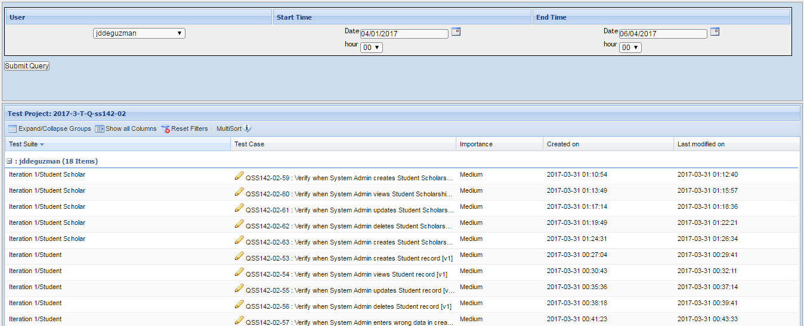
Test Cases – Individual

Slide 20
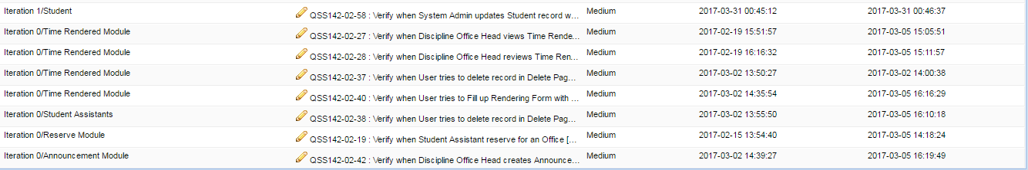
Test Cases – Individual

Slide 21
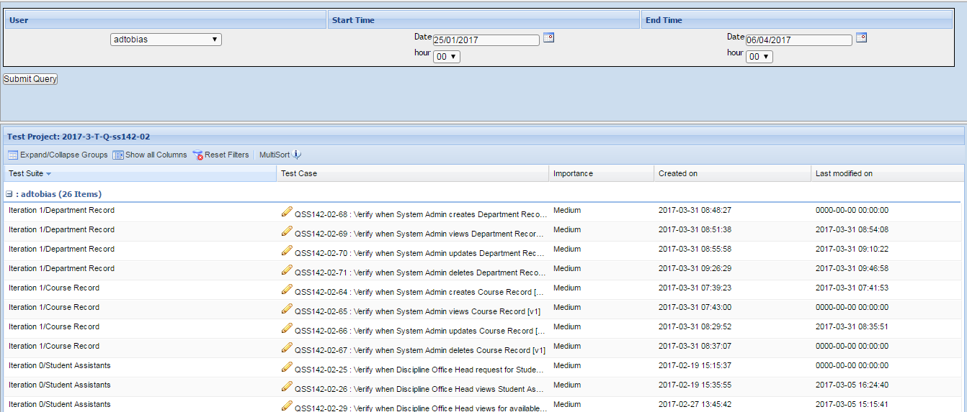
Test Cases - Individual

Slide 22
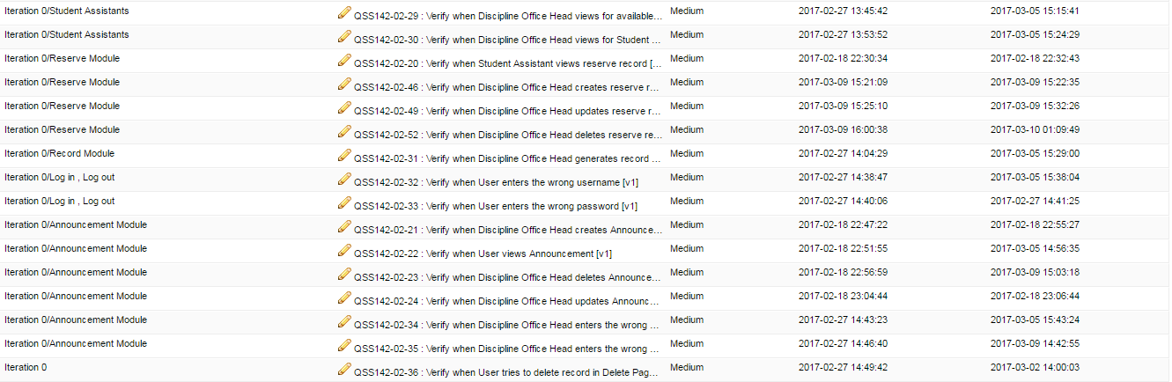
Test Cases - Individual

Slide 23
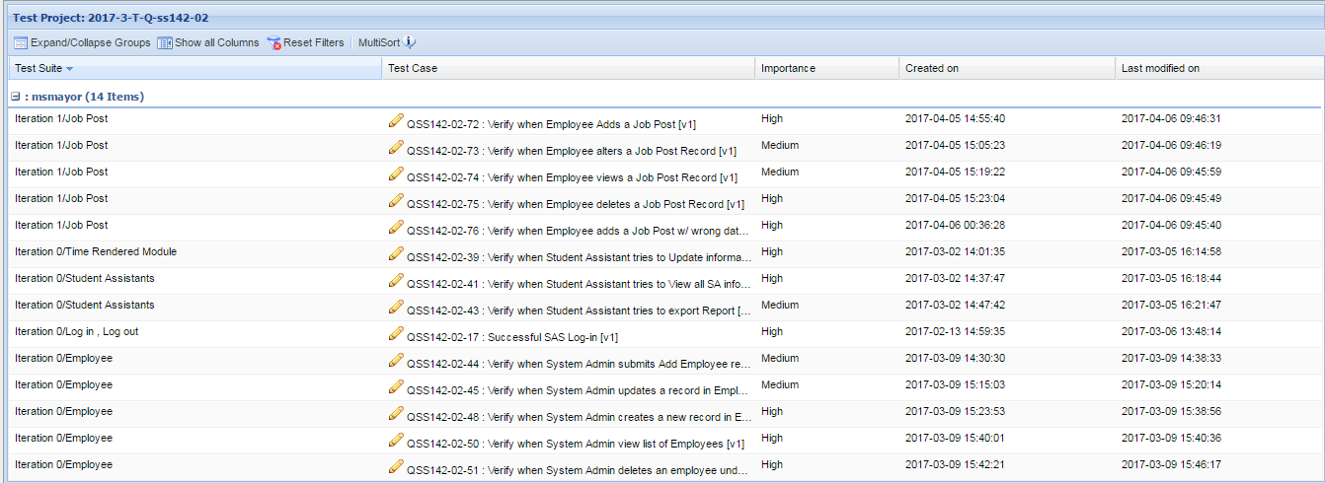
Test Cases - Individual

Slide 24
Test Plan Summary
TEST PLAN SUMMARY
USE CASE ITERATION 0
USE CASE ITERATION 1

